Slide 1
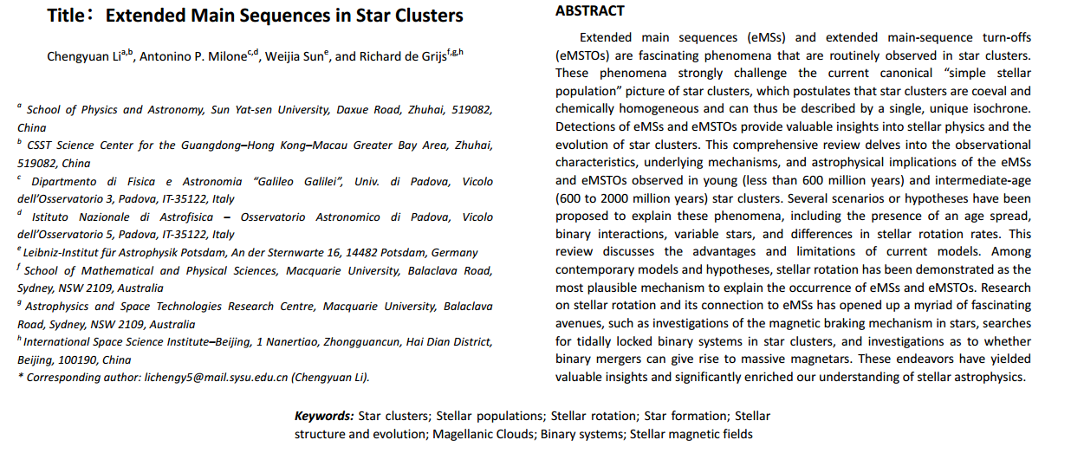
Paper Title

Slide 2
Cluster Age and Simple Stellar Populations (SSP)
Assumption of same age and chemical composition (SSP)
Founded in the quick and impactful stellar feedback
    Quickly evaporates the cluster gas, terminating the star-formation activity
But observed chemical composition (old clusters) and extended MS and MS Turnoff (eMSTO) could challenge that

Slide 3
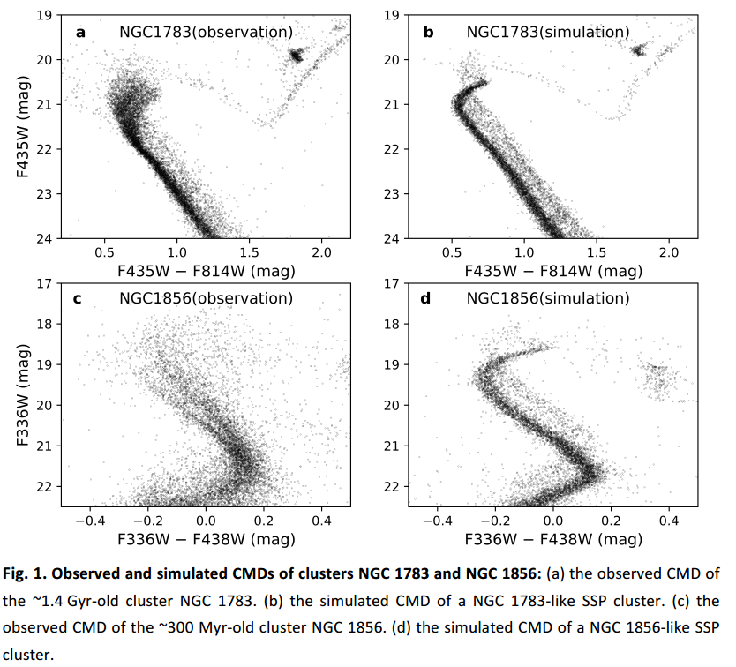
Extended MS and MS Turnoff

Slide 4
Extended MS and MS Turnoff
eMSTO

Slide 5
Extended MS and MS Turnoff
eMSTO
eMS

Slide 6
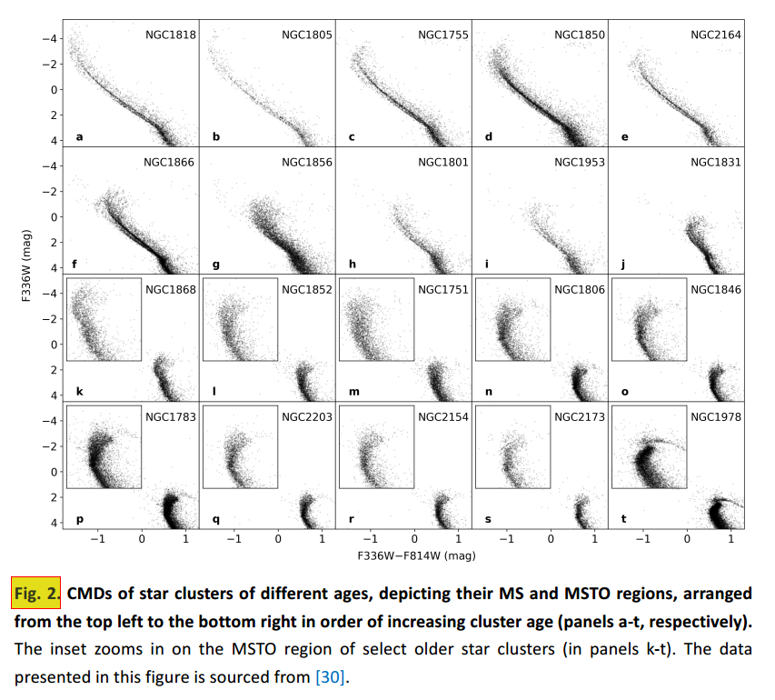
Extended MS and MS Turnoff
MS kink ≙ 1.5 M⊙
Notes:
This is also how you can determine the age of the cluster!
And the MS kink explains, why there are no Old Clusters with bifurcation: All massive stars died out and only the young ones with masses below that threshold are left, which eradicates the bifurcation

Slide 7
Observational Characteristics
Both can be seen in Intermediate and (albeit eMSTOs not commonly) in Young Clusters
    Stars in Young Clusters are not old enough to have reached the turnoff stage
    Stars in Old Cluster are not massive enough to reach the MS kink anymore, so no eMS and eMSTO are seen
Notes:
In other words, younger clusters tend to have smaller age spreads, whereas older clusters tend to have larger age spreads [66,67].

Slide 8
More Morphology – Red Clumps
Some Clusters (NGC 419, NGC 411) display dual/extended Red Clump Regions
    Connection to eMSTO?
    But contrasting results also exist (NGC 1831 i.e. has eMSTO but compact RC)
Also connected to subgiant branch?

Slide 9
More Morphology – subgiant branch
Subgiant Branch (SGB) is narrow, despite this indicating SSPs
    NGC 419 is a good example
    Wide blue section connecting eMSTO, but:
    Red section of SGB gradually narrows towards the bottom of the RGB

Slide 10
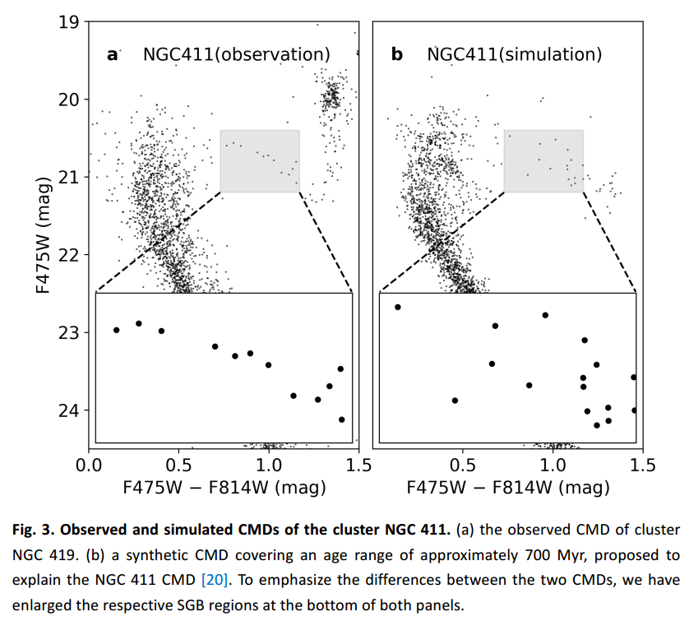
More Morphology – subgiant branch

Slide 11
More Morphology – B/BE dwarfs
“Be stars are B-type dwarfs with distinctive Balmer emission lines”
    Can be identified with filters to capture Hα wavelength (656.28 nm in Restframe) in observations
    Optically thick stellar atmospheres -> optically thin circumstellar disk generated by rapid stellar rotation?
Be stars are present in a notably fraction in clusters containing B-type dwarfs still on the MS
This may be connected to “UV-dim” stars;

Slide 12
More Morphology – “UV dim” stars
In older clusters like NGC 1783 no B-type dwarfs are left, but one observes A/F stars appearing much redder than typical
    Fainter in the blue color regions
    UV-dim
In younger clusters a significant number of Be stars also display UV-dim
    Implying a connection between reduced UV-flux and presence of circumstellar gas disk

Slide 13
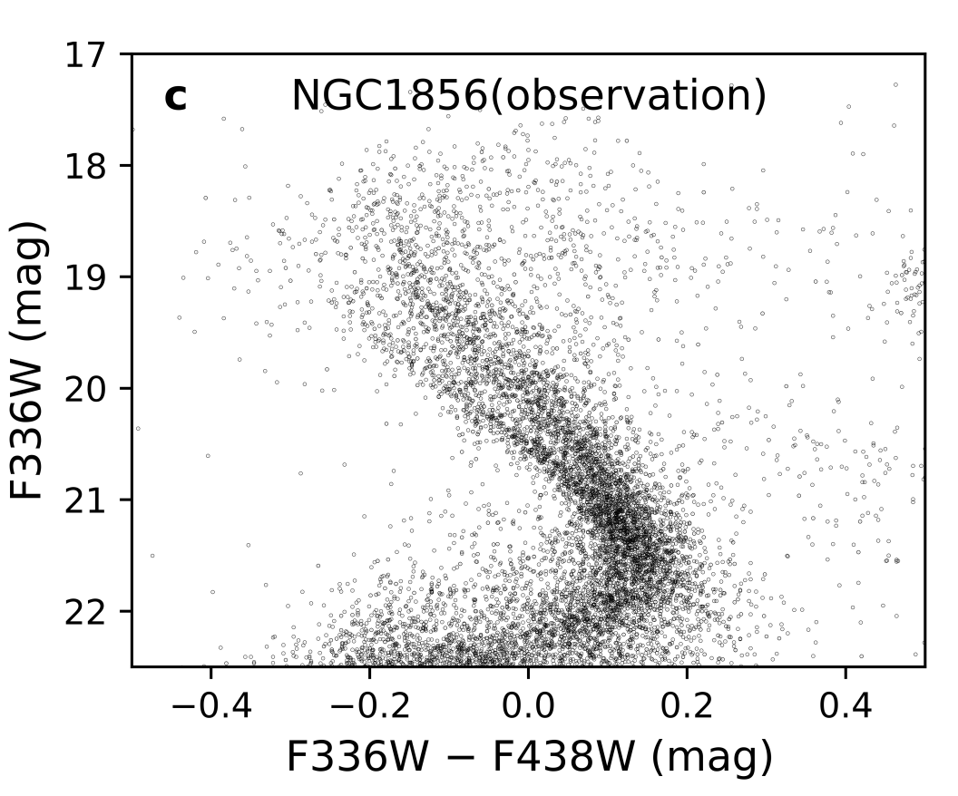
Spacial distribution of eMS(TO)
INTERMEDIATE AGE:
Higher degree of central concentration
(Also compared to RGB and AGB stars)
Lesser central concentration
Notes:
It was suspected that we have two population generations:
First generation star gas released would collect in the cluster center and trigger formation of younger and brighter second generation stars (bluer, to the left side).
This would however indicate a bigger mass segregation of the blue (left) side of the MS (bc the second generation is not born in the center, but outside), but apparently we don’t encounter that (end of p.8)

Slide 14
Spacial distribution of eMS(TO)
YOUNG AGE:
Less (!) or at most as likely centrally concentrated as the majority of MS dwarfs

Slide 15
Binary distribution of red and blue MS branches
NO large variations in stellar chem. abundances as in old GC
NO substantial difference in binary fraction in the r/b MS branches

Slide 16
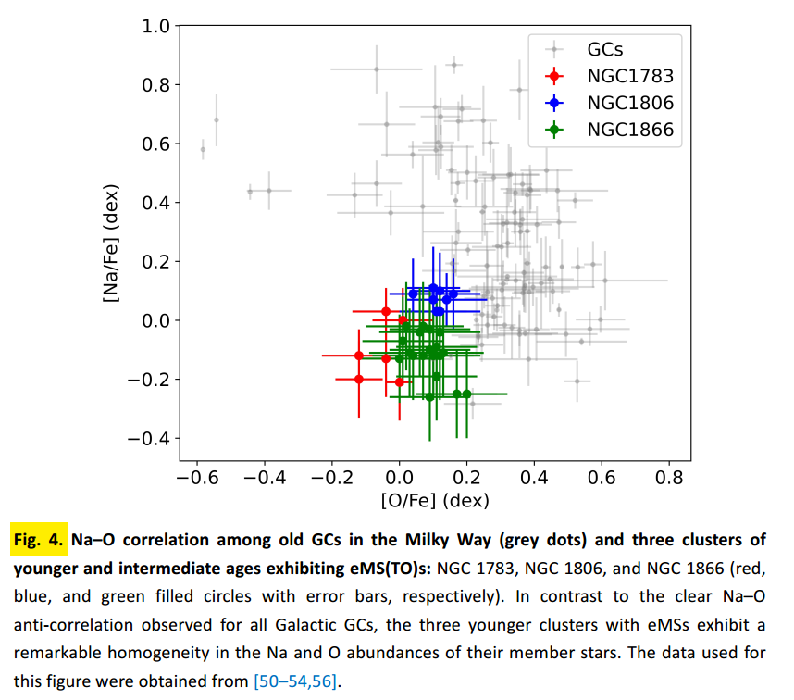
Stellar Chemical Abundances
NO large variations in stellar chem. abundances as in old GC

Slide 17
Proposed Explanations
Initially: SSP is a wrong aproach, age spread is needed
Stellar rotation might significantly alter the morphology of MSTOs

Slide 18
Age Spread
Age spread challenges many factors:
  Stellar winds would disperse the surrounding gas on short timescale
  Dominant contributors would have to most likely be AGB stars to keep star forming regions available
  Surveys failed to find such gas reserves or star formation present (no O- and pre-MS stars)

Slide 19
Age Spread
Age spread challenges many factors:
  Doesn’t explain other observed structures
  Expanded Red Clump Regions not omnipresent
  Sub Giant Branch not corresponding to age spread theory
In very young Clusters MSTOn can help limit age range
  “Stellar rotation may significantly alter the morphology of MSTOs”

Slide 20
Age Spread
“Younger clusters tend to have smaller age spreads, whereas older clusters tend to have larger age spreads”
  Reaches a maximum in at around ~1.5 Gyr
Intermediate age NGC 1846 was investigated for metallicity of both branches
  Similar metallicity despite age spread

Slide 21
Age Spread - Scenarios
Scenario: Cluster merged with either another cluster or a molecular cloud in a “super-cloud” system / cloud complex
Problem: Such mergers don’t happen as frequently as eMSTOs are observed (70% of interm. Clusters in LMC)
Problem: Little spatial distribution difference which would be expected for mergers
Problem: No explanation for the apparent age spread to age relationship

Slide 22
Age Spread - Scenarios
Scenario: Interactive Binaries can produce large fraction of younger stars
Problem: Interactive Binaries form a continuous distribution across the MSTO region, not a bi-furcated one (although this could still contribute additional confusion to the picture)
Problem: Cannot explain the extended Red Clumps unless incorporating an unusually high binary frequency
Problem: Doesn’t explain the absence of eMSTO in old clusters

Slide 23
Age Spread - Scenarios
Scenario: Variable stars (δ Scuti)
Problem: Just like with binaries, the number of δ Scuti stars is too small to produce a density distribution in the CMD

Slide 24
Age Spread - Scenarios
Scenario: Isochrone Clouds

Slide 25
Sources
https://arxiv.org/abs/2401.08062

Slide 26
Sources - Paper

